Slide 1
CLL Pilot WGS/RNASeq QC Review
IPS/Translational Bioinformatics
Nick Stong, Ph.D.

Slide 2
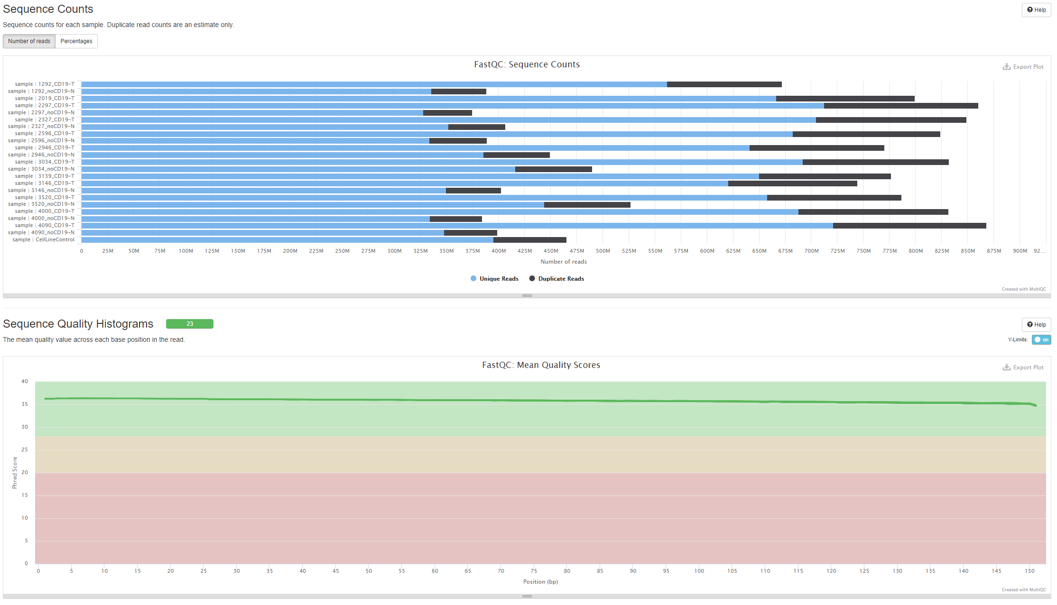
Picard/FastQC WGS

Slide 3
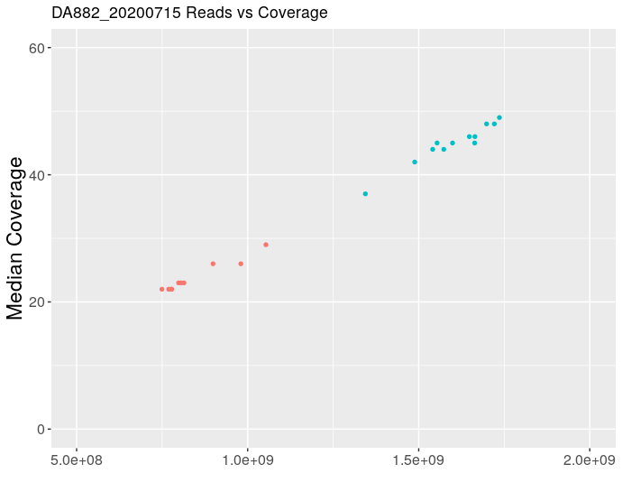
WGS Coverage
Expected coverage for tumor and normal samples
>40x Tumor (60x raw sequence)
>20x Normal (30x raw sequence)
Consistent with previous genome projects
Good library quality with consistent coverage for amount of sequence generated

Slide 4
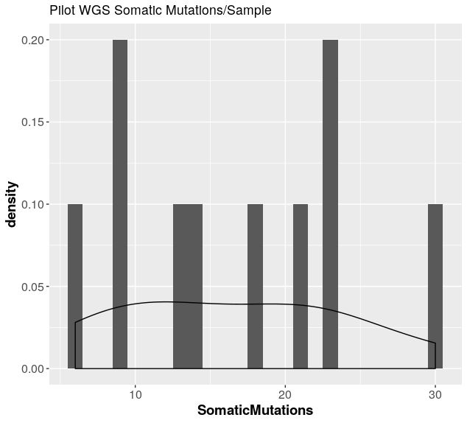
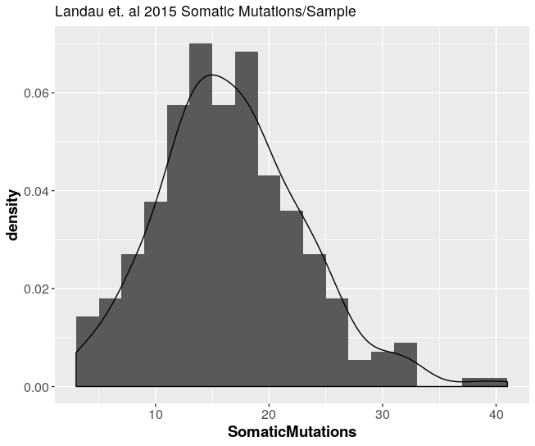
MUTECT2 Mutation Calls
Landau et. al 2015
16 median mutations
278 tumor/normal pairs
DA882_20200715
16 median mutations

Slide 5
MUTECT2 Mutation Calls
Sample | Qubit ug/ul | Total (ug) | CD19- cells recovered (MM) | % TIN | % live cells | SomaticMutations
2327 CD19- | 0.032 | 2.798 | 1.4 | 17 | 59.1 | 21
3146 CD19- | 0.025 | 2.2 | 3.2 | 15.2 | 28.7 | 13
1292 CD19- | 0.032 | 2.842 | 2.6 | 11 | 90.1 | 18
2297 CD19- | 0.005 | 0.402 | 1.4 | 7.6 | 35.4 | 9
3520 CD19- | 0.012 | 1.021 | 1.6 | 6.5 | 72.5 | 6
2946 CD19- | 0.02 | 1.778 | 1.2 | 4.4 | 66 | 9
3034 CD19- | 0.022 | 1.954 | 3.5 | 3.3 | 68.3 | 23
4000 CD19- | 0.024 | 2.094 | 1.3 | 3 | 61.2 | 23
2596 CD19- | 0.025 | 2.182 | 2 | 2.9 | 53.8 | 14
4090 CD19- | 0.027 | 2.332 | 3.6 | 2.17 | 75.7 | 30
Number of mutations not effected by TiN contamination

Slide 6
Pipeline
FASTQ
BAM
Tumor
Alignment (BWA)
Mutect2 Tumor/Normal
VCF
Filtering
HighQuality VCF
FASTQ
BAM
Normal
Alignment (BWA)
Tumor Only Pipeline
FASTQ
BAM
VCF
Filtering
HighQuality VCF
Alignment (BWA)
Mutect2 Tumor Only
Analysis VCF
FASTQ
BAM
Mutect2 Tumor Only
VCF
Filtering
HighQuality VCF
Alignment (BWA)
>25% VAF

Slide 7
MUTECT2 Mutation Calls Tumor Only Pipeline
Sample | Qubit ug/ul | Total (ug) | CD19- cells recovered (MM) | % TIN | % live cells | SomaticMutations | Tumor Only Pipeline
2327 CD19- | 0.032 | 2.798 | 1.4 | 17 | 59.1 | 21 | 104
3146 CD19- | 0.025 | 2.2 | 3.2 | 15.2 | 28.7 | 13 | 97
1292 CD19- | 0.032 | 2.842 | 2.6 | 11 | 90.1 | 18 | 109
2297 CD19- | 0.005 | 0.402 | 1.4 | 7.6 | 35.4 | 9 | 77
3520 CD19- | 0.012 | 1.021 | 1.6 | 6.5 | 72.5 | 6 | 62
2946 CD19- | 0.02 | 1.778 | 1.2 | 4.4 | 66 | 9 | 61
3034 CD19- | 0.022 | 1.954 | 3.5 | 3.3 | 68.3 | 23 | 83
4000 CD19- | 0.024 | 2.094 | 1.3 | 3 | 61.2 | 23 | 92
2596 CD19- | 0.025 | 2.182 | 2 | 2.9 | 53.8 | 14 | 86
4090 CD19- | 0.027 | 2.332 | 3.6 | 2.17 | 75.7 | 30 | 97
Many variants called from tumor only pipeline results in large files
WGS data called through Sentieon implementation
High number of somatic functional mutations
Limit to PASS in new version
Limit to hotspot genes

Slide 8
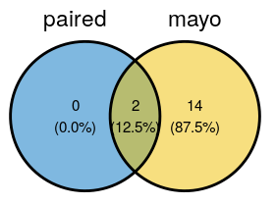
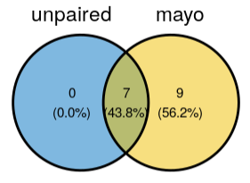
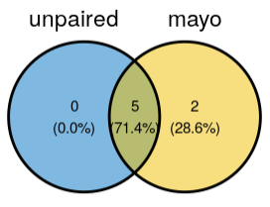
Recall of Mutation Panel Variants
All VAF > 10% variants are in the unfiltered tumor only variant calls
Two variants filtered due to tumor in normal contamination
1. High VAF at variant in normal (30%)
VAF at variant in tumor (50%)
Other KMT2D variant in sample has 21% VAF in normal sample
2. High VAF at variant in normal (42%)
Matches VAF of variant in tumor
No variant called in other TP53 variant in normal
Likely a truly germline variant
Filtering criteria will need to be tuned based on tumor in normal contamination
Use more sensitive parameters in genes of interest
Paired Tumor Normal Pipeline
Tumor Only Pipeline
Tumor Only Pipeline – VAF > 10%

Slide 9
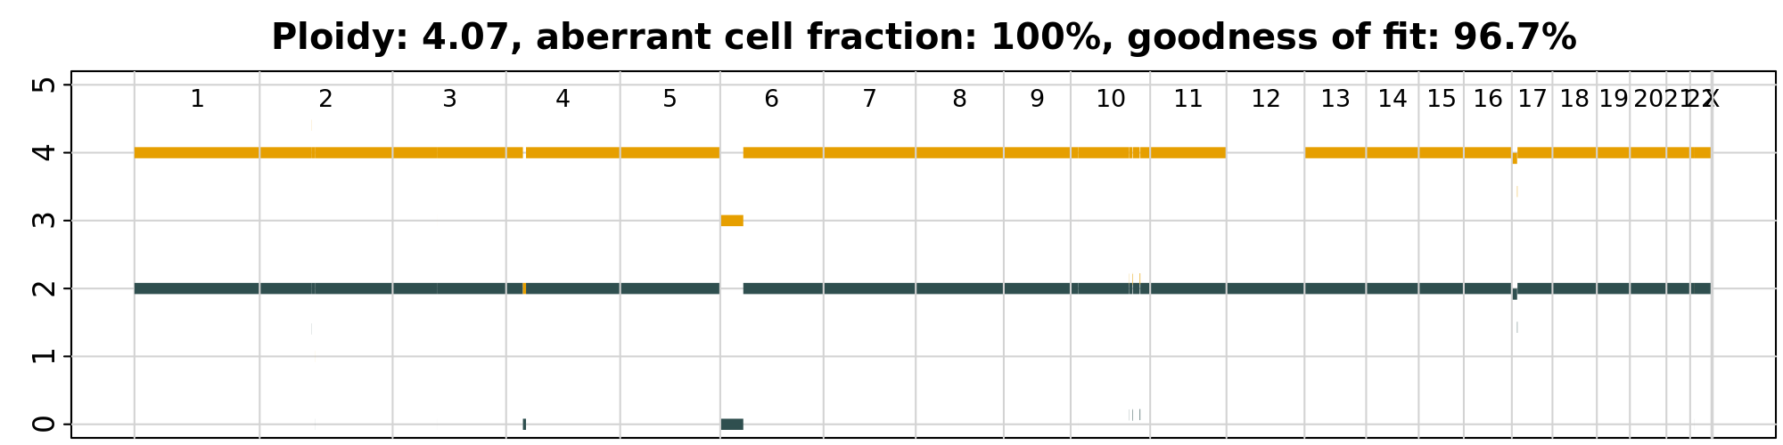
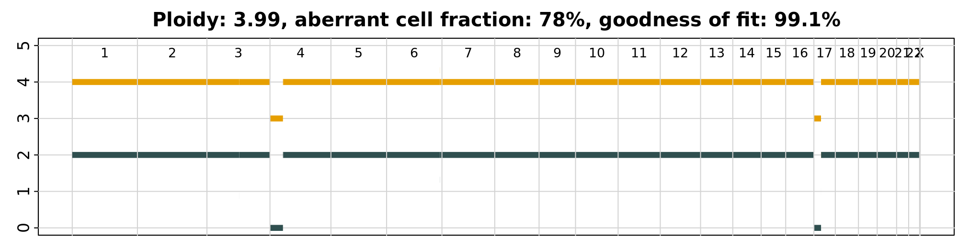
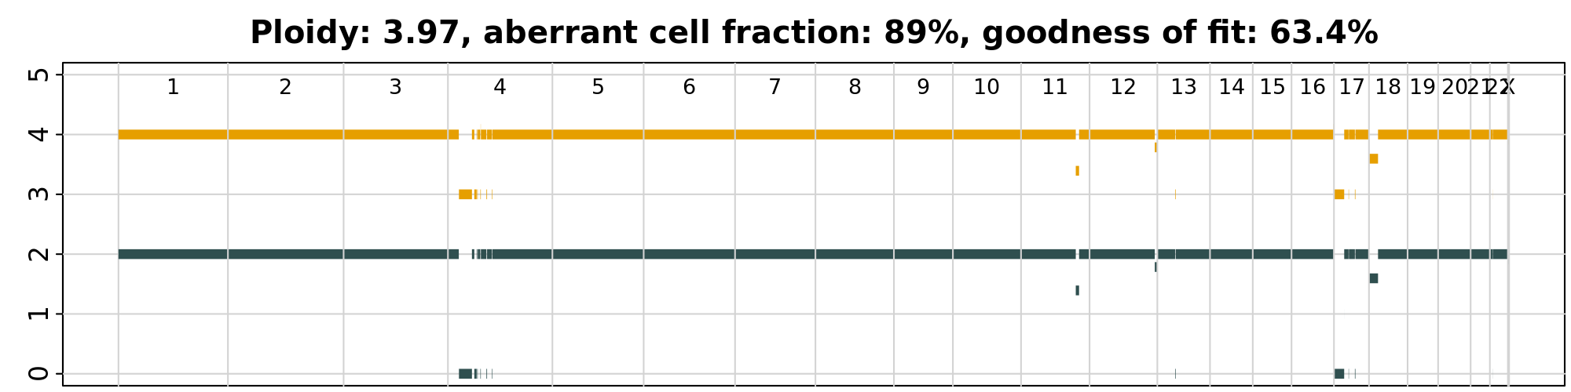
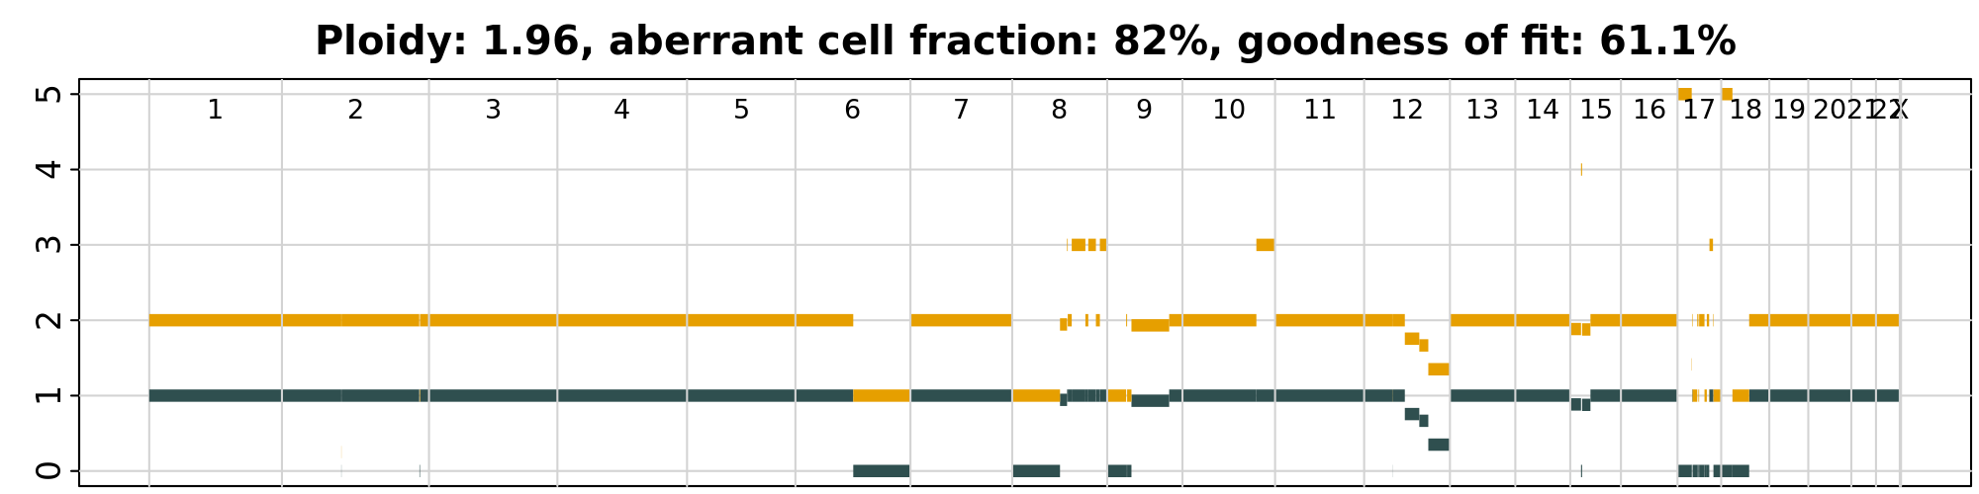
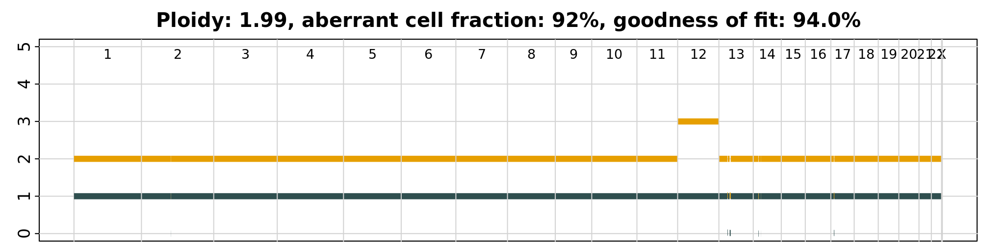
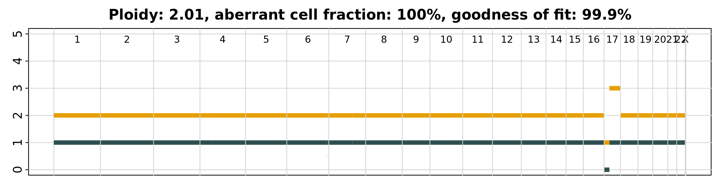
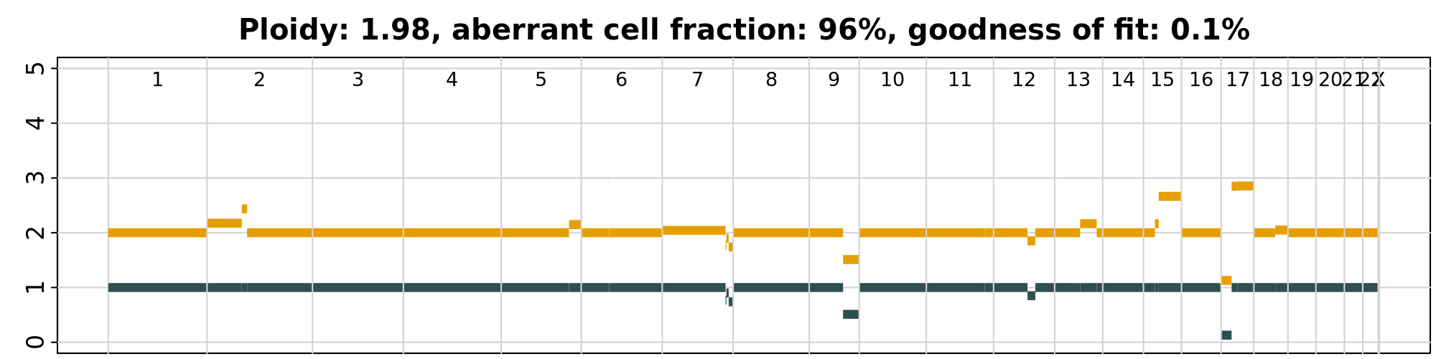
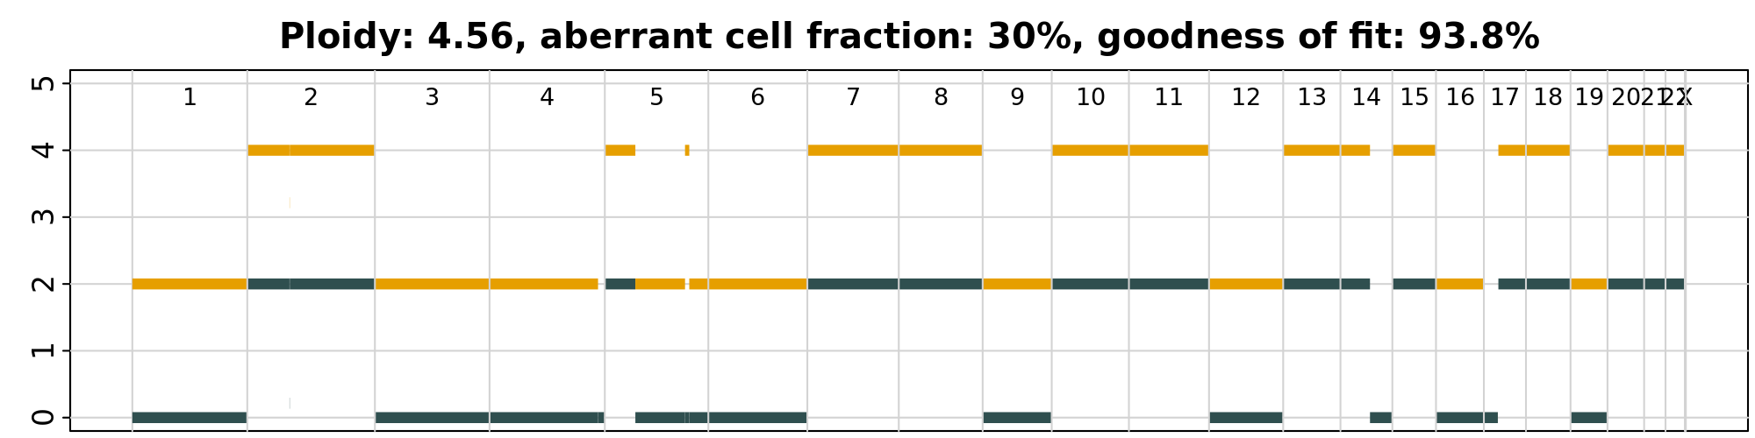
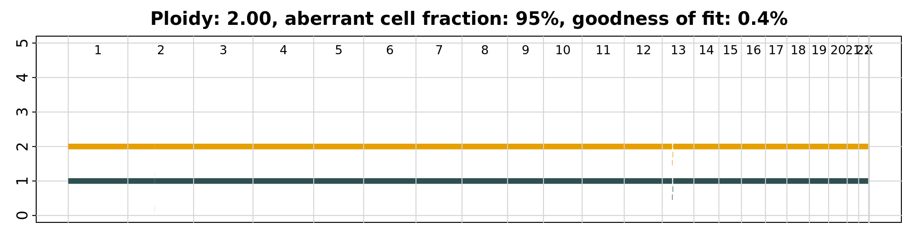
CNA Calls Battenberg
4000
4090
2297
2946
3250
2327
3146
1292
3034

Slide 10
SV Calls
Sample | SV Calls
2297 | 16
4000 | 41
3520 | 13
3034 | 25
2596 | 20
3146 | 24
1292 | 9
2327 | 24
2946 | 15
4090 | 16
Calls made by MANTA 1.6
Count of all PASS translocations
Previously used recurrent SV to filter
Limit to expected regions
Recurrent SVs in CLL?
Quality metric filtering can be used
Less sensitive
Correlation with complex karyotype?

Slide 11
del17P WGS/ RNAseq Pilot Study Summary
Results
Mayo will extract DNA/RNA (100ng) and ship to EA. Tumor and germline purity will be shared with BMS.
NGS pipeline work accomplished by optimizing and running alternative tumor only pipeline to account for
RNAseq data is satisfactory with at least x% of the reads uniquely mapped
WGS-Variants >10% VAF can be detected in the data; filtering will be tweaked as per TiN contamination in samples
CNV calling will be done by battenburg, continue to refine pipeline for calls and correlation to CK data
SV calling will be done by Manta; Continue to refine pipeline
Recommendation
No selection needed based on purity
Continue to refine pipeline for CNV and SV calls
Proceed with sample processing for RNAseq and WGS (60X tumor/30X germline)

Slide 12
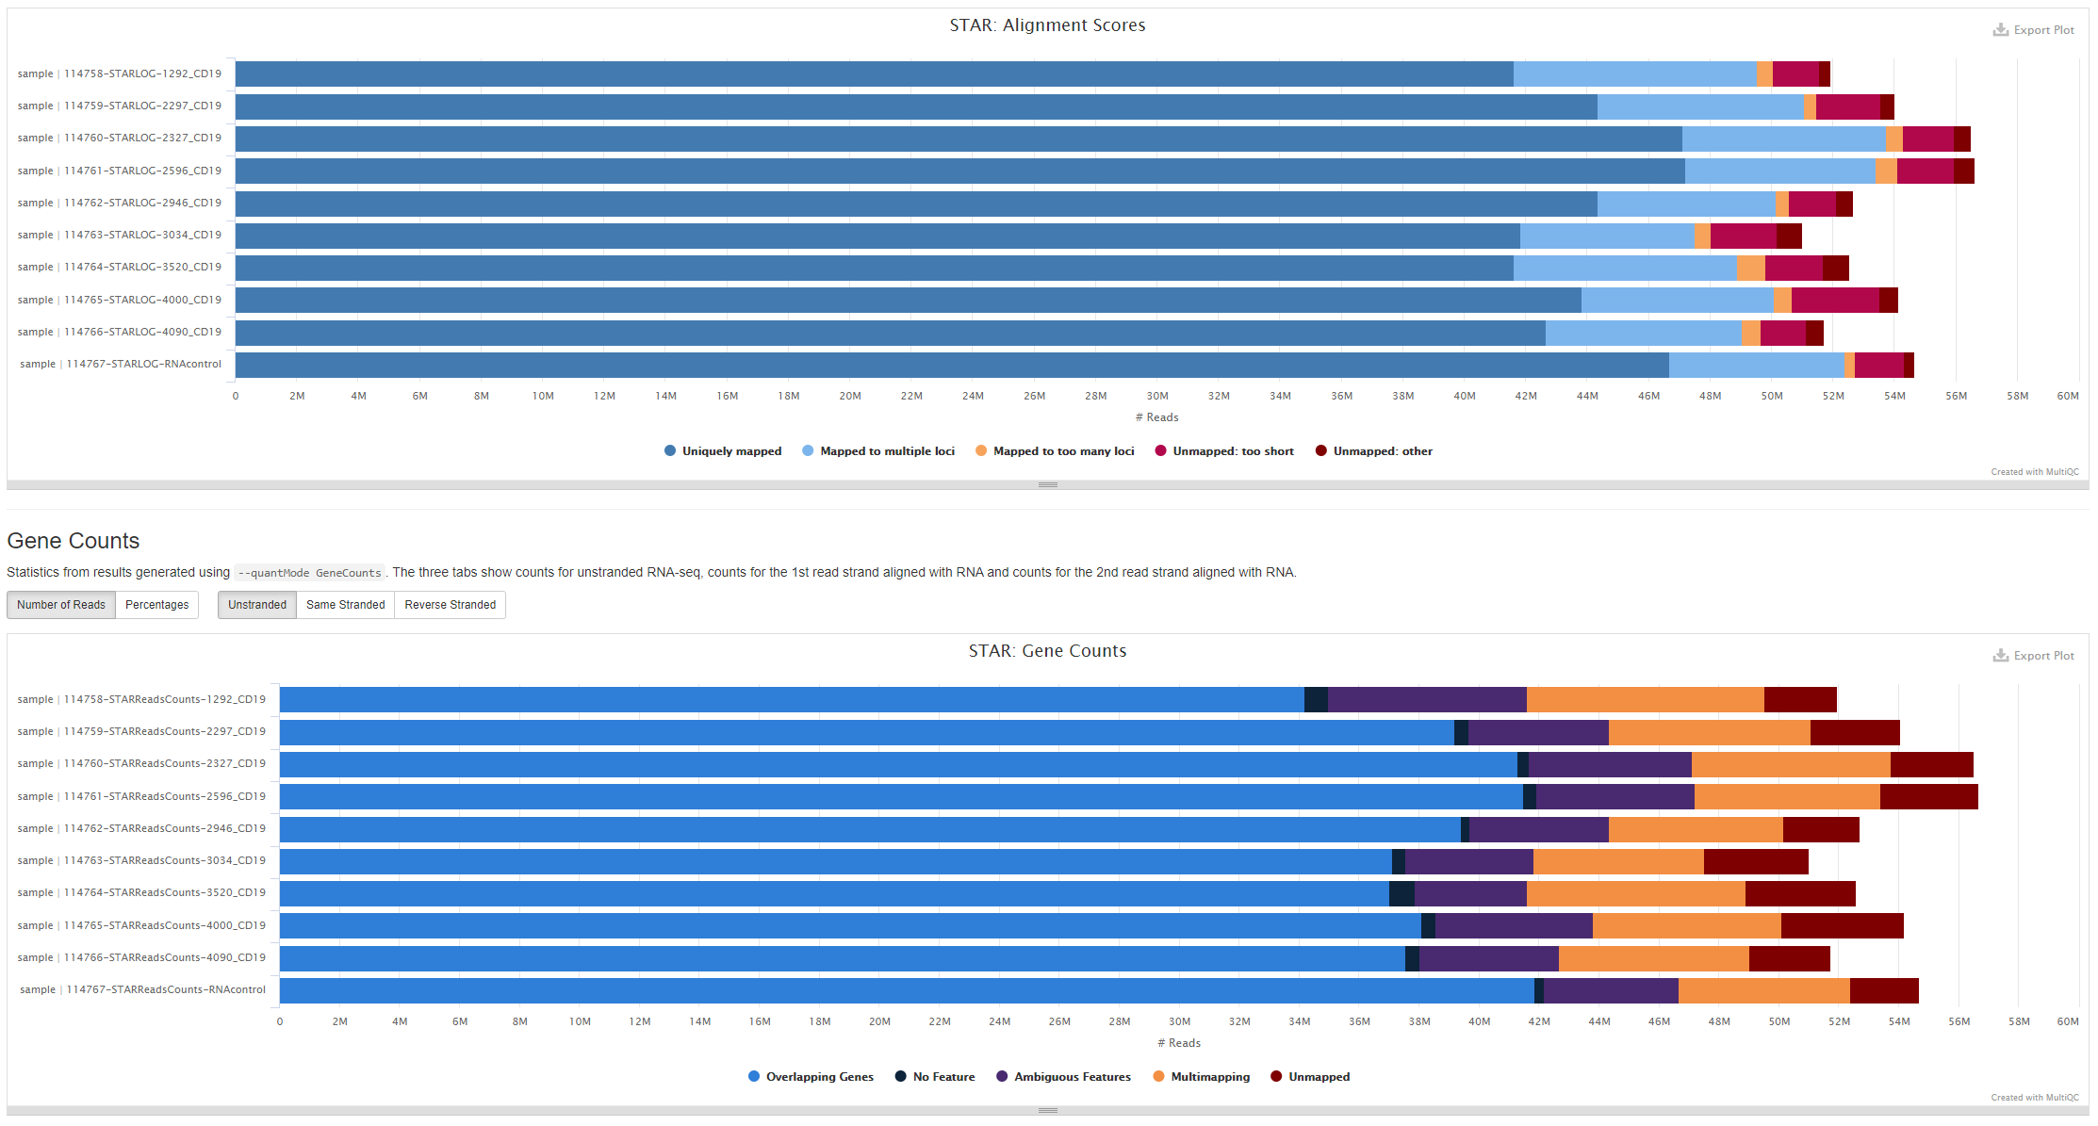
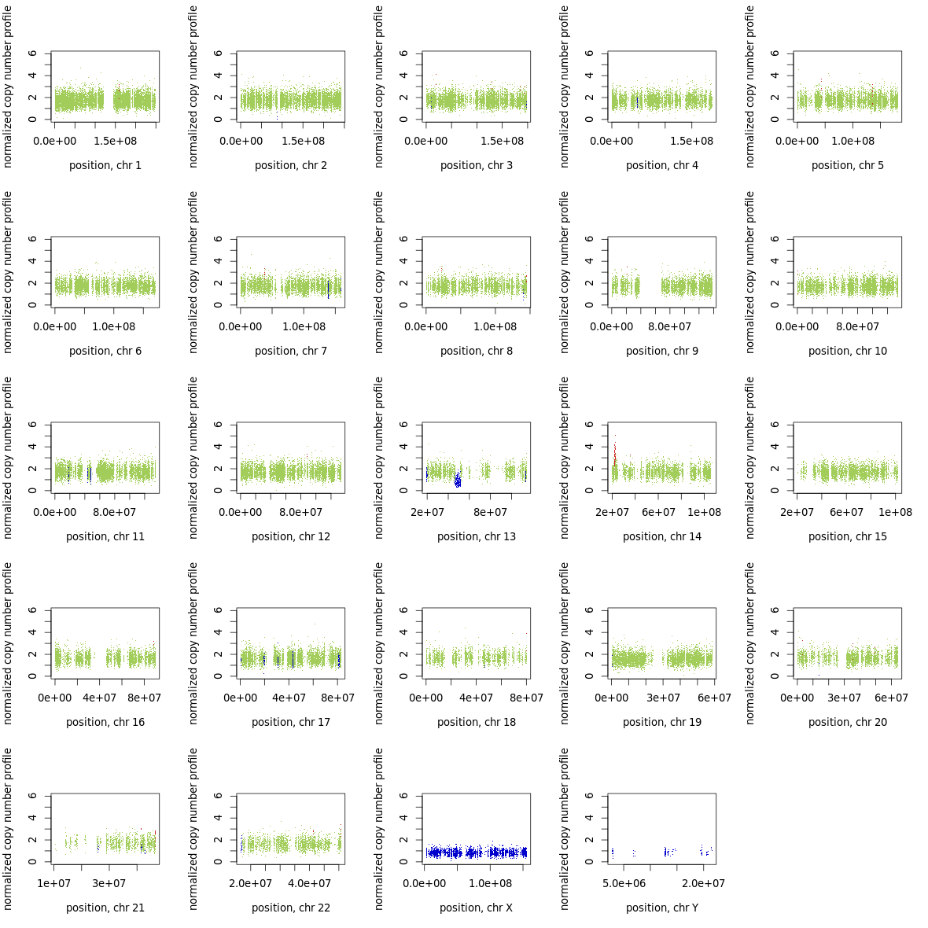
RNASeq MultiQC
 | Purity | Ploidy | Tumor Purity | Normal Contamination
CLL56 | 44.2% | 4 | 90 | ?
CLL33 | 41.1% | 3 | 94 | 6
CLL7 | 82.5% | 2 | 94 | 13
CLL19 | 44.7% | 4 | 95 | 22
ControlFREEC
Tumor/normal exome analysis
Also applies to WGS data
Provides CNV and subclonal calls
Does not depend on somatic SNVs
Not dependent on SNV pipeline
Troubleshooting Sclust as alternative

Slide 13
Backup

Slide 14
Recall of Mutation Panel Variants
ID | Gene | position (hg19) | position (hg38) | Ref | Alt |  |  | VAF | Called Paired | Called Unpaired
CLL2019 | TP53 | chr17:7577594 | chr17:7674276 | ACAGT | A | frameshift_variant | HIGH | 0.951 | NA | NA
CLL2297 | MGA | chr15:42041099 | chr15:41748901 | T | TA | frameshift_variant | HIGH | 0.050 | n | y
CLL2297 | MGA | chr15:42041828 | chr15:41749630 | TAAAAC | T | frameshift_variant | HIGH | 0.048 | n | n
CLL2596 | ATM | chr11:108200960 | chr11:108330233 | C | T | stop_gained | HIGH | 0.529 | n | n¹
CLL2596 | KMT2D | chr12:49423021 | chr12:49029238 | T | C | splice_donor_variant | HIGH | 0.470 | n | y (42% VAF)
CLL2946 | NXF1 | chr11:62563936 | chr11:62796464 | C | G | missense_variant | MODERATE | 0.495 | n | n²
CLL2946 | TP53 | chr17:7577534 | chr17:7674216 | C | A | missense_variant | MODERATE | 0.885 | n | y
CLL2946 | ASXL1 | chr20:31023612 | chr20:32435809 | G | T | stop_gained | HIGH | 0.026 | n | n
CLL2946 | DDX3X | chrX:41203379 | chrX:41344126 | AAAG | A | splice_donor_variant | HIGH | 0.087 | n | n
CLL4090 | TP53 | chr17:7578221 | chr17:7674903 | TTC | T | frameshift_variant | HIGH | 0.014 | n | n
CLL4090 | TP53 | chr17:7578280 | chr17:7674962 | G | GA | frameshift_variant | HIGH | 0.096 | n | n
CLL4090 | TP53 | chr17:7578398 | chr17:7675080 | G | C | missense_variant | MODERATE | 0.012 | n | n
CLL4090 | TP53 | chr17:7578534 | chr17:7675216 | CTTG | C | inframe_deletion | MODERATE | 0.014 | n | n
CLL4090 | TP53 | chr17:7579311 | chr17:7675993 | C | T | splice_donor_variant | HIGH | 0.097 | n | y
CLL4090 | ZMYM3 | chrX:70466210 | chrX:71246360 | ACTTC | A | frameshift_variant | HIGH | 0.398 | n | y
CLL4090 | TP53 | chr17:7577570 | chr17:7674252 | C | T | missense_variant | MODERATE | 0.224 | n | y
CLL4090 | TP53 | chr17:7578212 | chr17:7674894 | G | A | stop_gained | HIGH | 0.149 | y | y
All VAF > 10% variants are in the unfiltered tumor only variant calls
Some filtered due to only one or two reads supporting mutation
Variants are almost all in the tumor / normal only pipeline output
1. High VAF at variant in normal (30%)
VAF at variant in tumor (50%)
Other KMT2D variant in sample has 21% VAF in normal sample
2. High VAF at variant in normal (42%)
Matches VAF of variant in tumor
No variant called in other TP53 variant in normal
Likely a truly germline variant
Filtering criteria will need to be tuned based on tumor in normal contamination
Use more sensitive parameters in genes of interest

